Slide 1



Lung and colon cancer prediction for histopathological images using deep learning
TEAM NO:19A13
PRESENTED BY GUIDED BY
BHARATHI S (19CSR016) KALAIVANI P
DHARANI G (19CSR036) AP/CSE
DHIVYA A (19CSR039)

Slide 2
INTRODUCTION
1.Deep learning is a subset of machine learning - neural network with three or more layers.
It requires large amounts of labeled data
It requires significant computational power (high performing GPUs)
2. Deep learning algorithms can perform complex operations efficiently.
3.Deep Neural Networks find associations between a set of inputs and outputs.

Slide 3
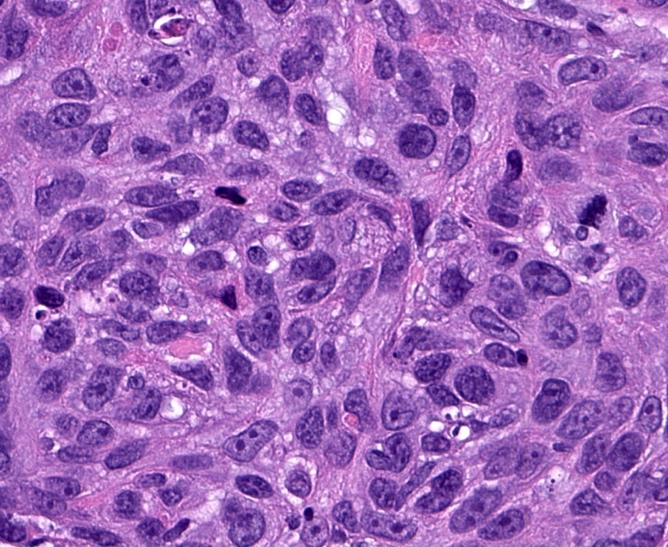
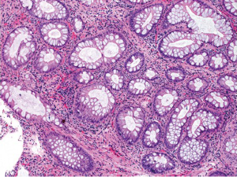
INTRODUCTION
LUNG CANCER
Lung cancer begins in the lungs and may spread to lymph nodes.
Lung cancer requires a biopsy of the suspected tissue be histologically
examined for cancer cells.
COLON CANCER
Colon cancer is a type of cancer that begins in the large intestine.
Histology for determining the depth of tumor invasion in colon.
HISTOPATHOLOGICAL IMAGES
microscopic examination of a biopsy
dyed with one or more stains.

Slide 4
PROBLEM STATEMENT
In manual extraction - final model will have low generalization error .
Among many types of cancers, the lung and colon variants are the most common and deadliest ones. Early prediction and proper treatment are currently the only way to reduce the number of deaths due to cancer .
For the cancer diagnosis, visual inspection and manual procedures are typically used. This interpretation of medical images is error-prone and time-consuming.
CNN 🡪 Artificial neural network
medical image processing
image/object recognition and classification.

Slide 5
LITERATURE SURVEY
S.NO | PAPER | AUTHOR | YEAR | METHOD AND ALGORITHM | ACCURACY
1 | Machine Learning-based Lung and Colon Cancer Detection using Deep Feature Extraction and Ensemble Learning | Md. Alamin Talukdera, Manowarul Islama,Ashraf Uddina | 2022 | VGG | 99.30%
2 | Prediction of lung and colon cancer through analysis of histopathological images by utilizing Pre-trained CNN models with visualization of class activation and saliency maps | Satvik garg, somya garg | 2021 | InceptionResNetV2, InceptionV3, DenseNet169, | 97.5%
3 | Deep Learning predictive model for colon cancer patient using CNN based classification | Zarrin Tasnim,Chakraborty,Ali Newaz | 2021 | MobileNetV2 | 99.67%

Slide 6
LITERATURE SURVEY
S.NO | PAPER | AUTHOR | YEAR | METHOD AND ALGORITHM | ACCURACY
4 | Deep learning for colon cancer histopathological images analysis | A. Ben Hamida,, M. Devanne , J. Weber | 2021 | VGG -16 | 81.22%
5 | Malignancy Detection in Lung and Colon Histopathology Images Using Transfer Learning With Class Selective Image Processing | Shahid Mehmood, Taher M. Ghazal, Muhammad Adnan Khan | 2022 | AlexNet | 98.4%
6 | A novel transfer learning approach for the classification of histological images of colorectal cancer | Elene Firmeza Ohata, João Victor Souza das Chagas | 2021 | DenseNet169 with SVM RBF | 92.083%

Slide 7
Existing System
For image pre-processing histogram equalization technique was used to improve the picture quality.
A pre-trained neural network (AlexNet) was tuned by modifying the four of its layers before training it on the dataset.
The implementation of this methodology has improved the overall
accuracy from 89% to 98.4%.

Slide 8
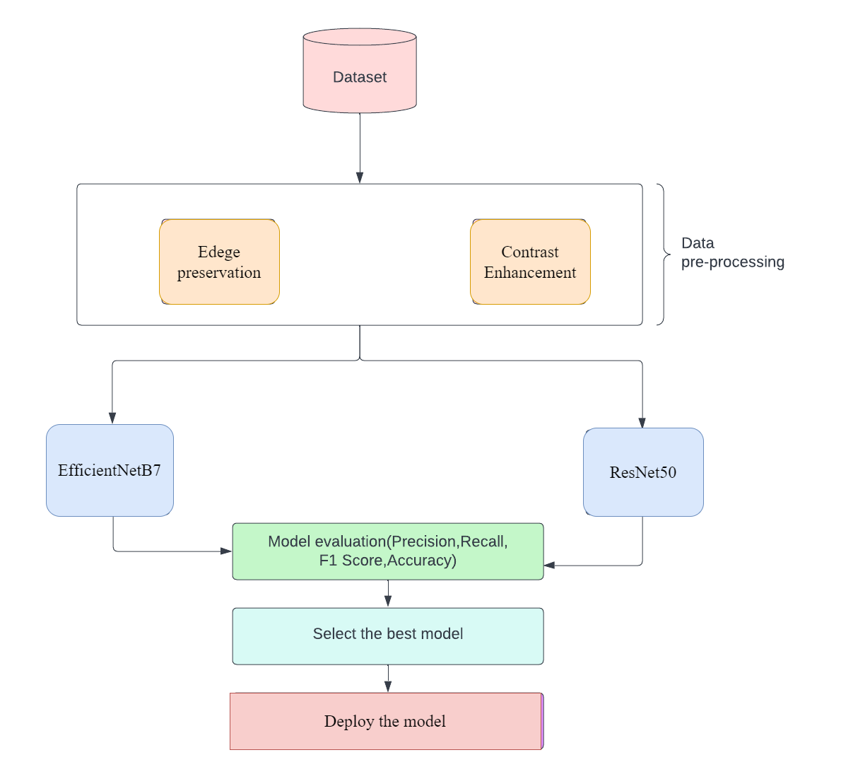
PROPOSED SYSTEM

Slide 9
MODULES
Data Pre-processing
Model Creation
Feature Extraction
Classification
Metrics Comparison
18/02/2023

Slide 10
DATASETS
DATASET
LINK:https://www.kaggle.com/datasets/andrewmvd/lung-and-colon-cancer-histopathological-images
DESCRIPTION: The above dataset contains 25,000 histopathological images with 5 classes. All images are 768 x 768 pixels in size and are in jpeg file format.
The five classes are
1.Lung benign tissue
2.Lung adenocarcinoma
3.Lung squamous cell carcinoma
4.Colon adenocarcinoma
5.Colon benign tissue
18/02/2023

Slide 11
EVALUATION METRICS
The performance is calculated in terms of four measures,
Accuracy
Recall
F1-Score
Precision rate
18/02/2023

Slide 12
REFERENCE
Talukder, Md Alamin, et al. "Machine learning-based lung and colon cancer detection using deep feature extraction and ensemble learning." Expert Systems with Applications 205 (2022): 117695.
Garg, Satvik, and Somya Garg. "Prediction of lung and colon cancer through analysis of histopathological images by utilizing Pre-trained CNN models with visualization of class activation and saliency maps." 2020 3rd artificial intelligence and cloud computing conference. 2020.
Tasnim, Zarrin, et al. "Deep learning predictive model for colon cancer patient using CNN-based classification." Int. J. Adv. Comput. Sci. Appl 12 (2021): 687-696.

Slide 13
Hamida, A. Ben, et al. "Deep learning for colon cancer histopathological images analysis." Computers in Biology and Medicine 136 (2021): 104730.
Mehmood, Shahid, et al. "Malignancy detection in lung and colon histopathology images using transfer learning with class selective image processing." IEEE Access 10 (2022): 25657-25668.
Ohata, Elene Firmeza, et al. "A novel transfer learning approach for the classification of histological images of colorectal cancer." The Journal of Supercomputing (2021): 1-26.
Toğaçar, Mesut. "Disease type detection in lung and colon cancer images using the complement approach of inefficient sets." Computers in Biology and Medicine 137 (2021): 104827.

Slide 14
THANK YOU..!

